Slide 1
Introducing Classes
Week 5

Slide 2
Agenda
Creating Classes in Java
Java Class instance variables
Java Class Methods
Java Objects
Accessing instance variables and Methods with objects
Using Access Specifiers
Using Setter and Getter Methods
Using Constructors
Using this keyword

Slide 3
Class Fundamentals
It defines a new data type.
Once defined, this new type can be used to create objects of that type.
Thus, a class is a template for an object, and an object is an instance of a class.
The two words object and instance used interchangeably.
A class is declared by use of the class keyword.
General form of a class is shown here.

Slide 4
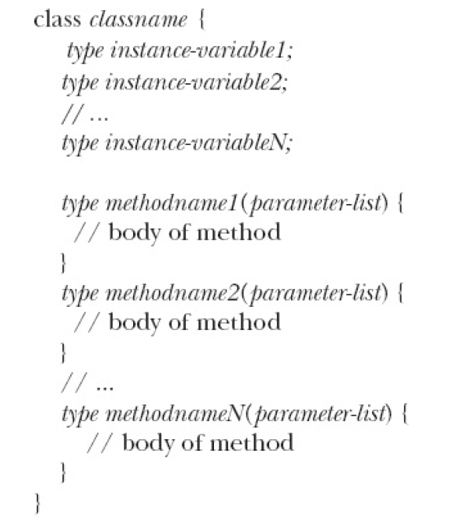
Class Fundamentals

Slide 5
Class Fundamentals
Instance variables
Methods
Members of the class

Slide 6
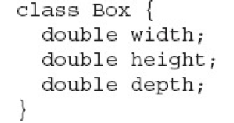


Class Fundamentals

Slide 7
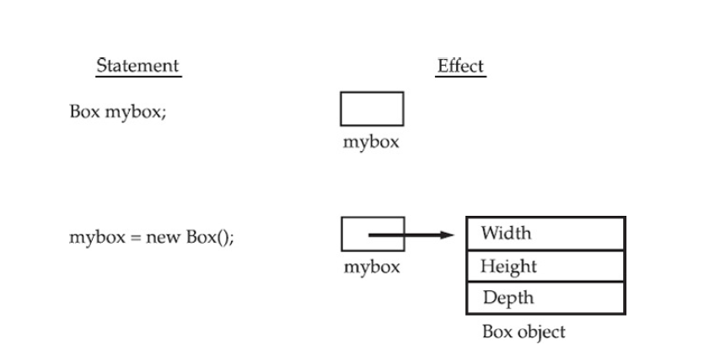
Class Fundamentals

Slide 8
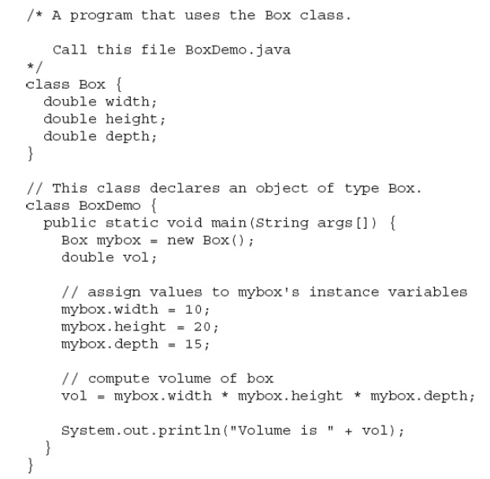

Slide 9
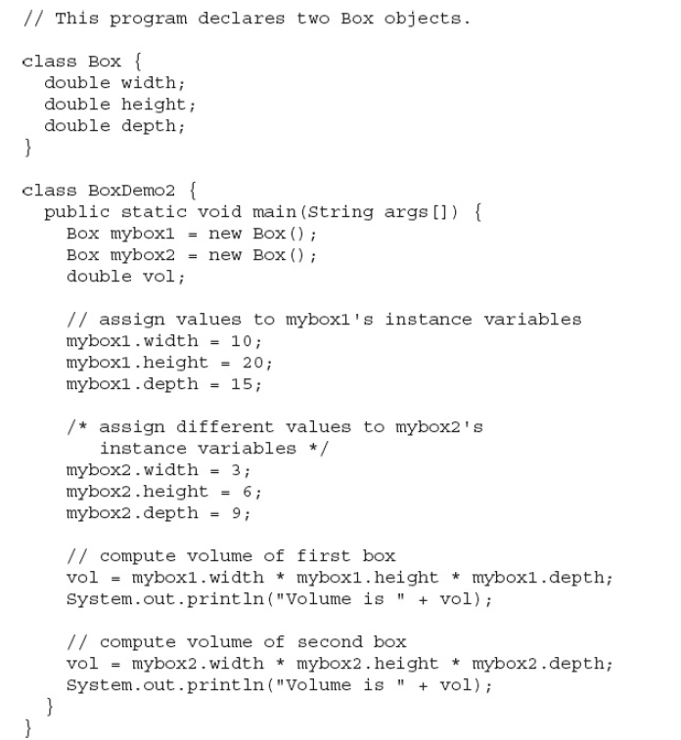

Slide 10

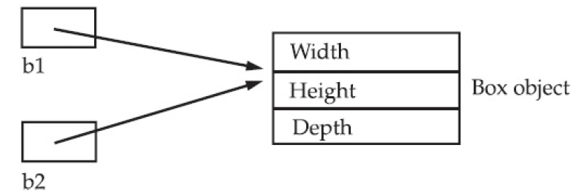
Assigning Object Referencing Variables

Slide 11
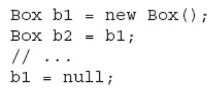
Assigning Object Referencing Variables
Here, b1 and b2 will both refer to the same object. The assignment of b1 to b2 did not allocate any memory or copy any part of the original object. It simply makes b2 refer to the same object as does b1. Thus, any changes made to the object through b2 will affect the object to which b1 is referring, since they are the same object.
Although b1 and b2 both refer to the same object, they are not linked in any other way.

Slide 12
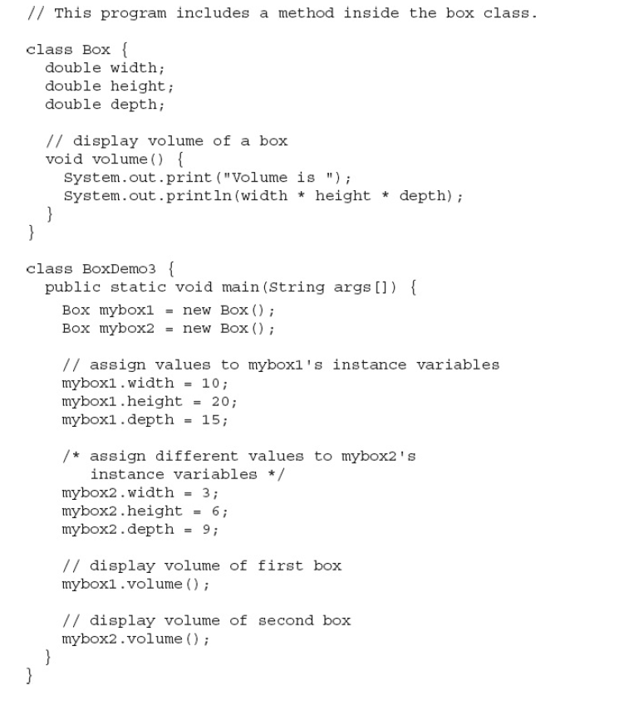
Adding Methods to Box Class

Slide 13
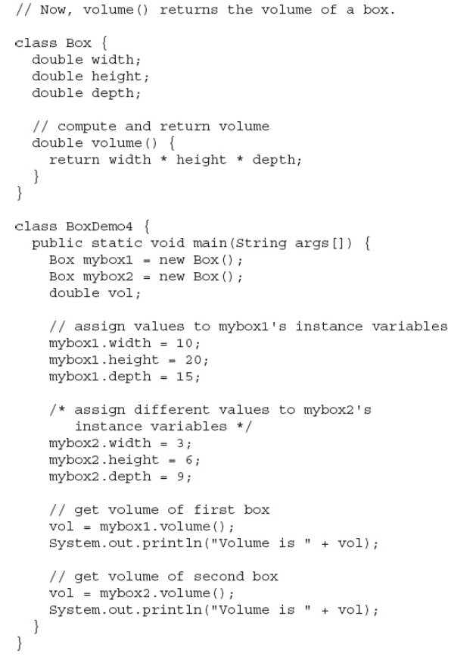
Adding Methods to Box Class that returns value

Slide 14
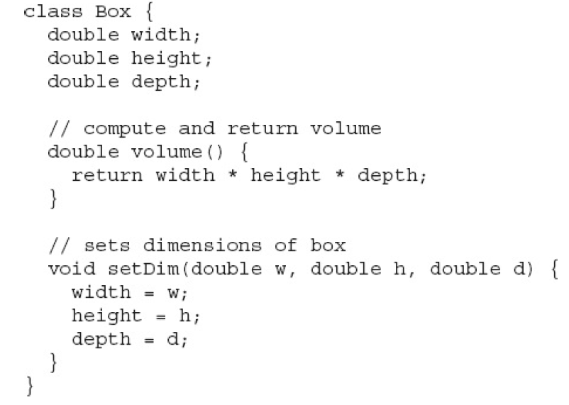
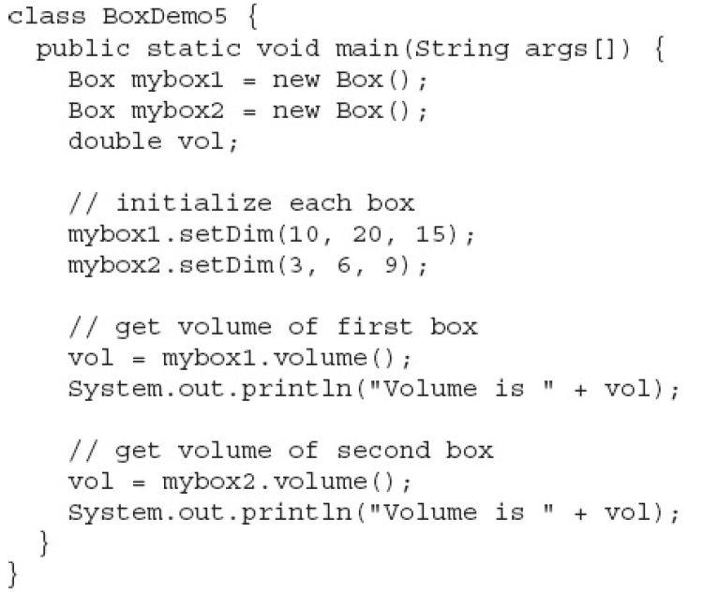
Adding a Method That Takes Parameters

Slide 15
Constructors
Specialized method that have the same name as the class.
They are used to initialize the class variables.
They don’t have any return type. Not even void.
They call automatically when you create the object of any class using new keyword.

Slide 16
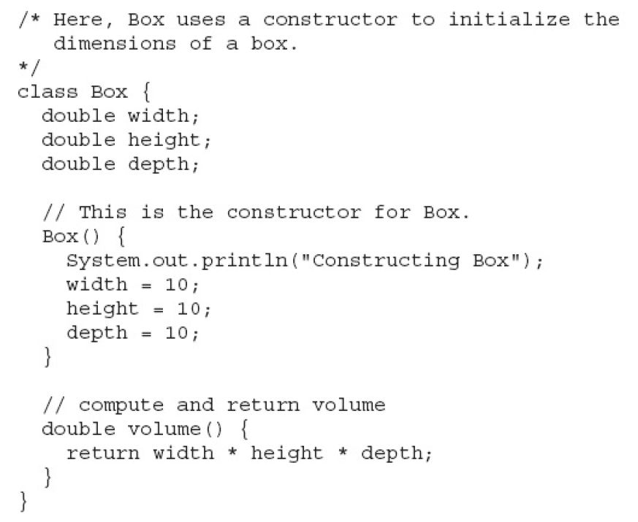

Slide 17
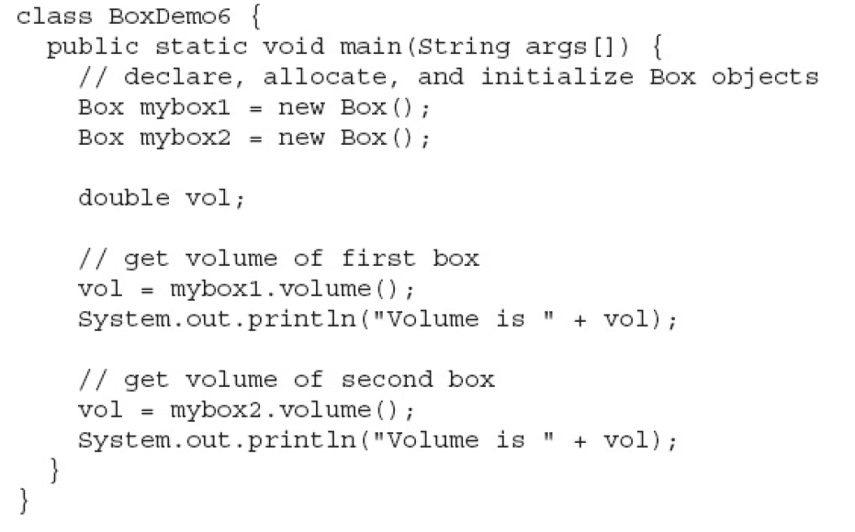

Slide 18
Parameterized Constructors
While the Box() constructor in the preceding example does initialize a Box object, it is not very useful—all boxes have the same dimensions.
What is needed is a way to construct Box objects of various dimensions.
The easy solution is to add parameters to the constructor.
Pay special attention to how Box objects are created.

Slide 19
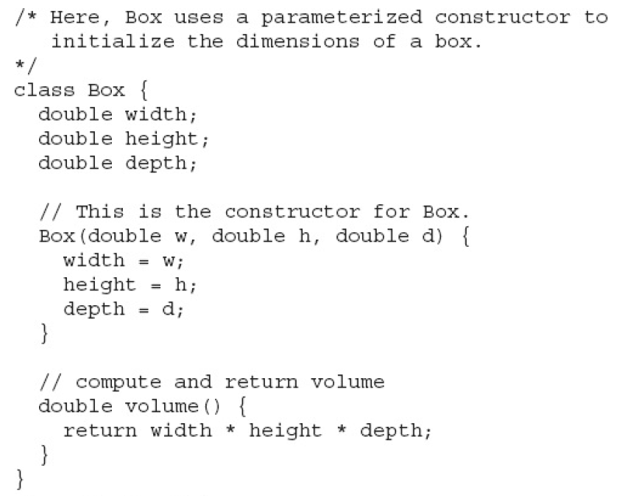

Slide 20
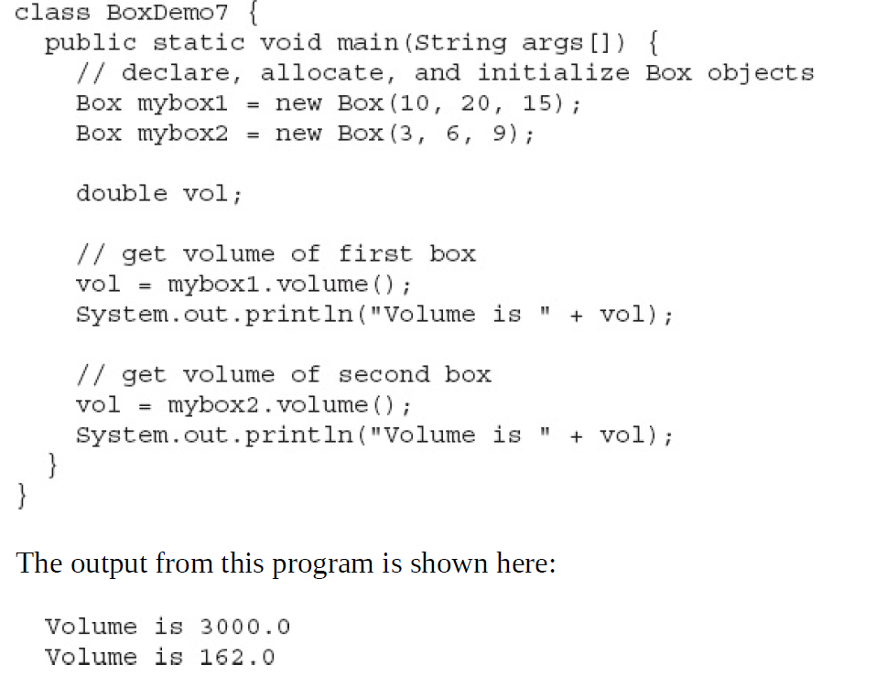

Slide 21
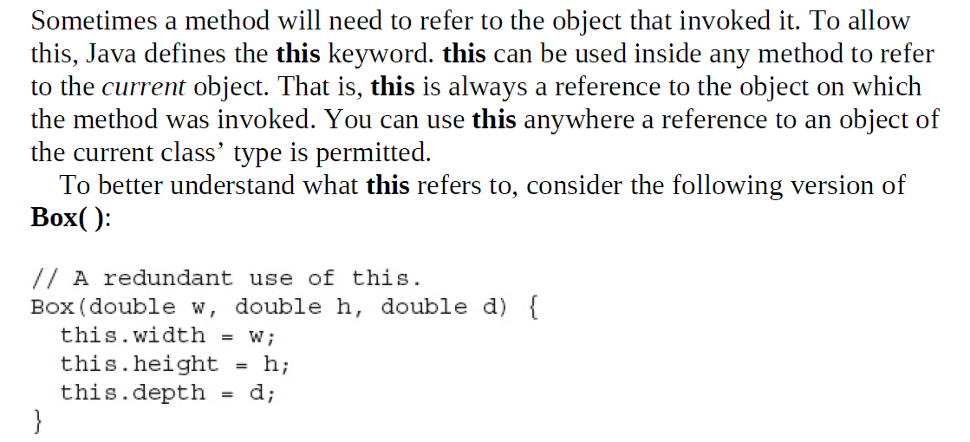
The this keyword

Slide 22
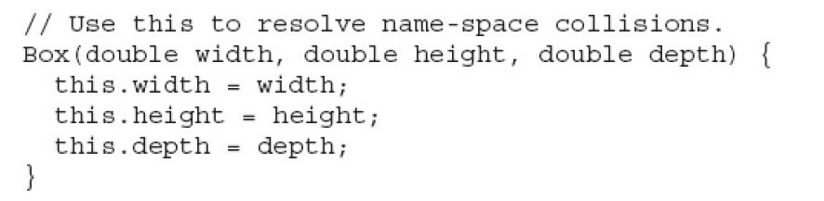
The this keyword

Slide 23
Garbage Collection
Since objects are dynamically allocated by using the new operator, you might be wondering how such objects are destroyed and their memory released for later reallocation.
In some languages, such as C++, dynamically allocated objects must be manually released by use of a delete operator.
Java takes a different approach; it handles deallocation for you automatically. The technique that accomplishes this is called garbage collection.

Slide 24
The finalize () Method
Sometimes an object will need to perform some action when it is destroyed.
For example, if an object is holding some non-Java resource such as a file handle or character font, then you might want to make sure these resources are freed before an object is destroyed. To handle such situations, Java provides a mechanism called finalization.
By using finalization, you can define specific actions that will occur when an object is just about to be reclaimed by the garbage collector.

Slide 25
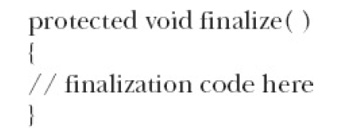
The finalize () Method
To add a finalizer to a class, you simply define the finalize( ) method. The Java run time calls that method whenever it is about to recycle an object of that class. Inside the finalize( ) method, you will specify those actions that must be performed before an object is destroyed.
This method deprecated now.

Slide 26
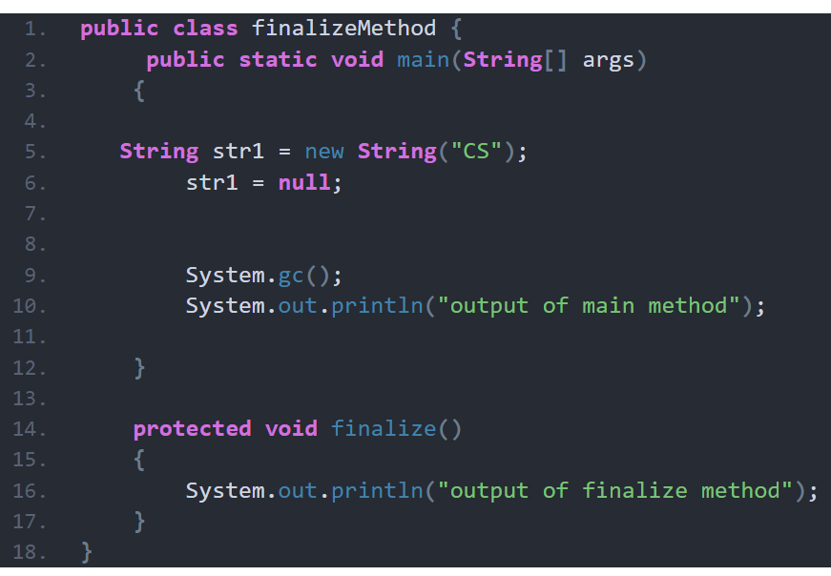

Slide 27
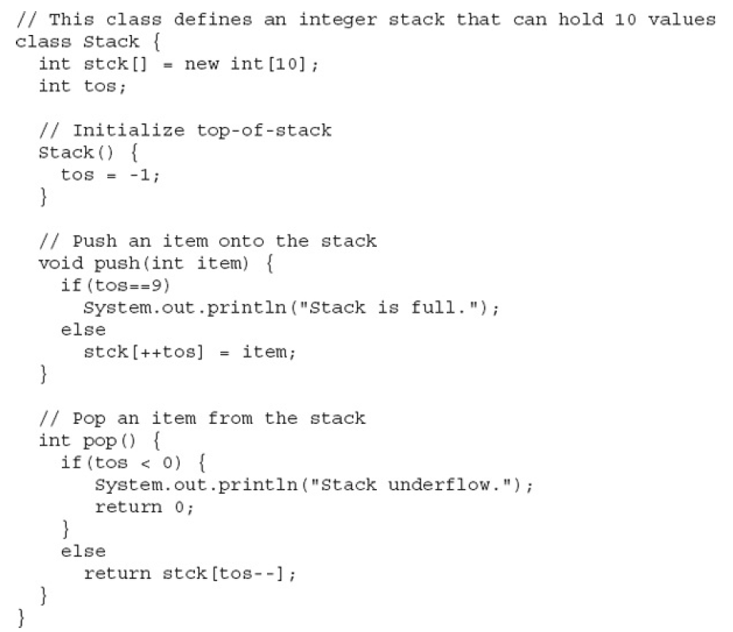
Stack Class: More Practical Example

Slide 28
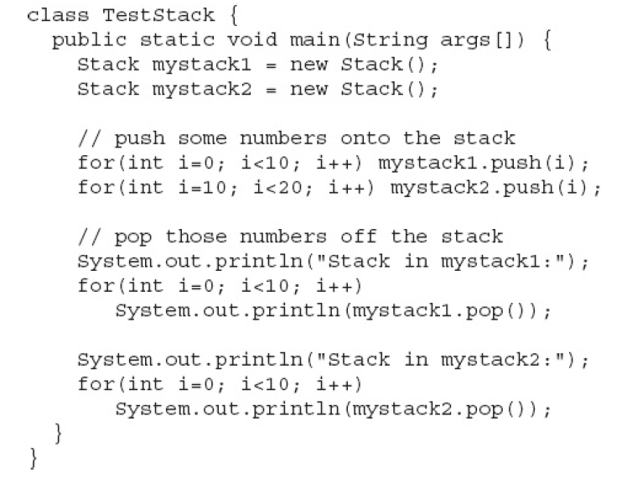
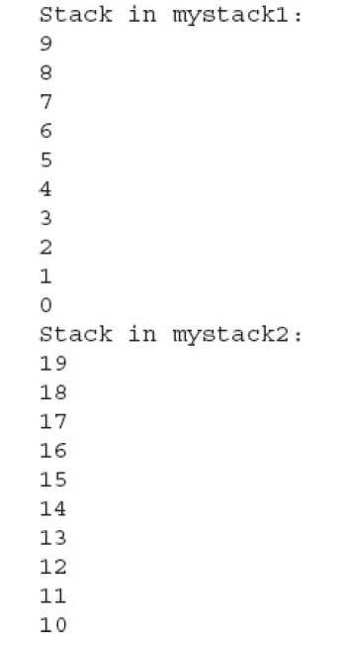
Stack Class: More Practical Example

